Slide 1
Important Keywords:
Declaration
Abstract Methods
Concrete Methods
Definition

Slide 2
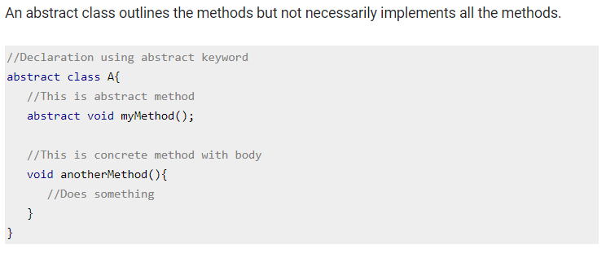
Abstract class declaration

Slide 3
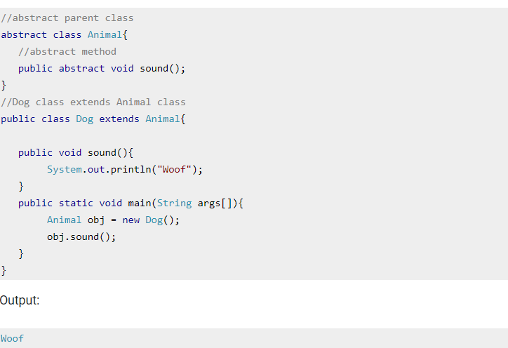
Abstract class Example

Slide 4
Abstract Class
A class that is declared using “abstract” keyword is known as abstract class. It can have abstract methods(methods without body) as well as concrete methods (regular methods with body).
An abstract class can not be instantiated, which means you are not allowed to create an object of it.

Slide 5
Rules
Note 1: A class derived from the abstract class must implement all those methods that are declared as abstract in the parent class.
Note 2: Abstract class cannot be instantiated which means you cannot create the object of it. To use this class, you need to create another class that extends this this class and provides the implementation of abstract methods, then you can use the object of that child class to call non-abstract methods of parent class as well as implemented methods(those that were abstract in parent but implemented in child class).
Note 3: If a child does not implement all the abstract methods of abstract parent class, then the child class must need to be declared abstract as well.

Slide 6
Why can’t we create the object of an abstract class?
Because these classes are incomplete, they have abstract methods that have no body so if java allows you to create object of this class then if someone calls the abstract method using that object then What would happen?There would be no actual implementation of the method to invoke.
Also because an object is concrete. An abstract class is like a template, so you have to extend it and build on it before you can use it.

Slide 7
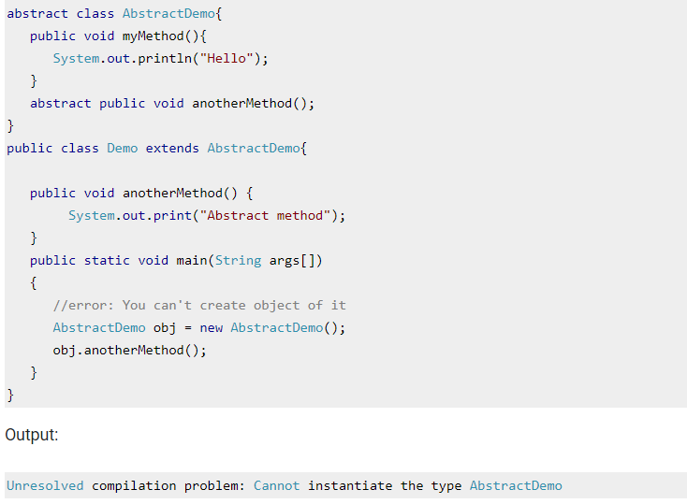
Example to demonstrate that object creation of abstract class is not allowed

Slide 8
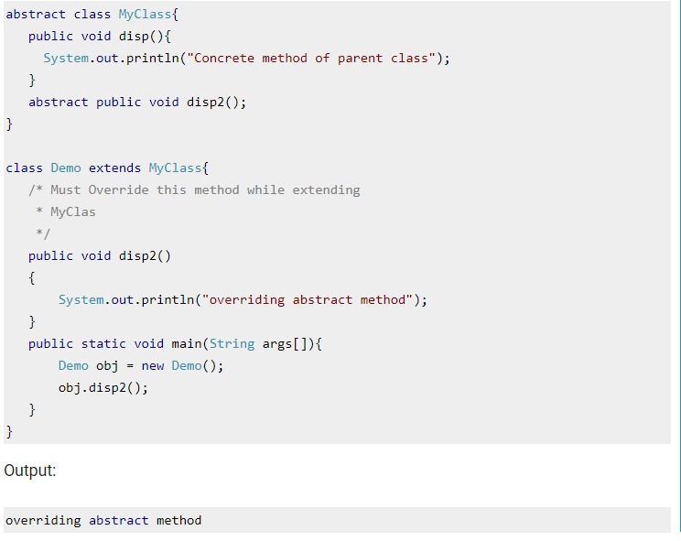
Example of Abstract class and method

Slide 9
Can a abstract class have a constructor ?
Ans: Abstract class can also have constructor because constructors are not used for creating object, constructors are used to initialize the data members of a class and Abstract class can also have data member and for initialize the data member of abstract class need a constructor if we did not provide the constructor then jvm supply the 0-param or default constructor for initializing the data member.

Slide 10
How can you access concrete methods in abstract class ?
Ans: You cannot access the concrete methods of an abstract class unless you extend the class. An abstract class is actually almost useless on their own.
You can see an abstract class like a lazy student who has to be told to read his books; if he doesn’t get told, he won’t be able to read his books. Telling the student is now analogous to extending the abstract class and the student then reading his books is analogous to the execution of the concrete methods

Slide 11
Interface
Unlike abstract class an interface is used for full abstraction. Abstraction is a process where you show only “relevant” data and “hide” unnecessary details of an object from the user.
Interface looks like a class but it is not a class. An interface can have methods and variables just like the class but the methods declared in interface are by default abstract (only method signature, no body)
The variables declared in an interface are public, static & final by default.

Slide 12
Interfaces in Java 8 (Interview Question)
Prior to java 8, interface in java can only have abstract methods. All the methods of interfaces are public & abstract by default. Java 8 allows the interfaces to have default and static methods. The reason we have default methods in interfaces is to allow the developers to add new methods to the interfaces without affecting the classes that implements these interfaces.
Static methods in interfaces are similar to the default methods except that we cannot override these methods in the classes that implements these interfaces.

Slide 13
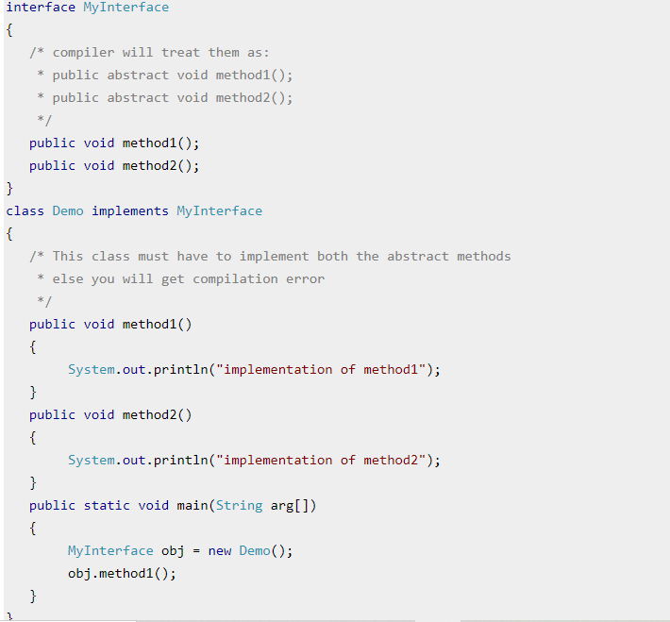
Example of an Interface in Java

Slide 14
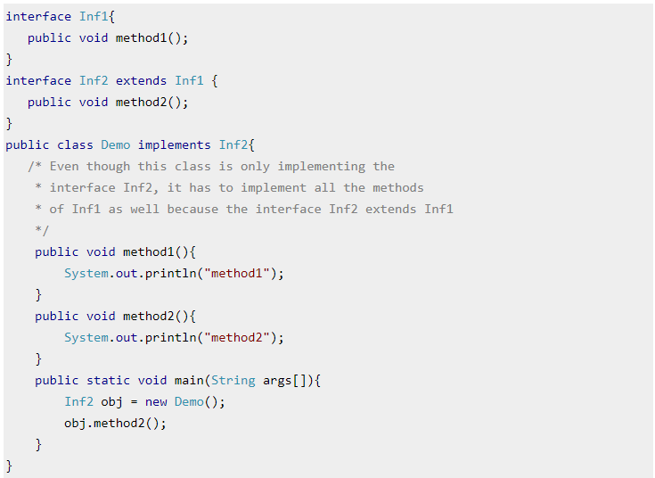
Interface and Inheritance Interface can extend the other interface. We have two interfaces Inf1 and Inf2. Inf2 extends Inf1 so If class implements the Inf2 ,it has to provide implementation of all the methods of interfaces Inf2 as well as Inf1.

Slide 15
Key points for interface:
1) We can’t instantiate an interface in java. That means we cannot create the object of an interface
2) Interface provides full abstraction as none of its methods have body. On the other hand abstract
class provides partial abstraction as it can have abstract and concrete(methods with body) methods both.
3) implements keyword is used by classes to implement an interface.
4) While providing implementation in class of any method of an interface, it needs to be mentioned as public.
5) Class that implements any interface must implement all the methods of that interface, else the class should be declared abstract.
6) Interface cannot be declared as private, protected or transient.
7) All the interface methods are by default abstract and public.
8) Variables declared in interface are public, static and final by default.

Slide 16
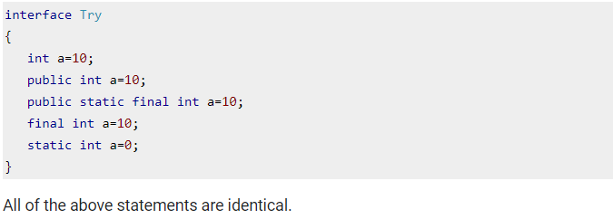

Slide 17
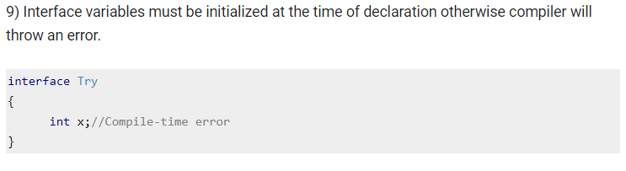
This code will throw a compile time error.

Slide 18
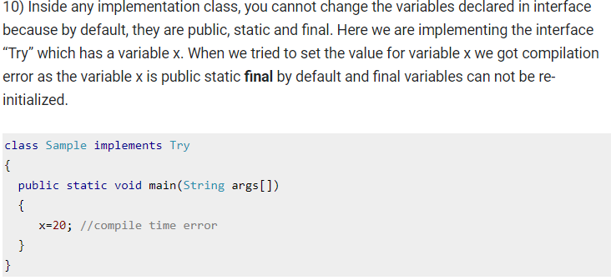

Slide 19
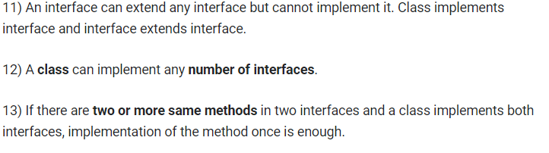

Slide 20
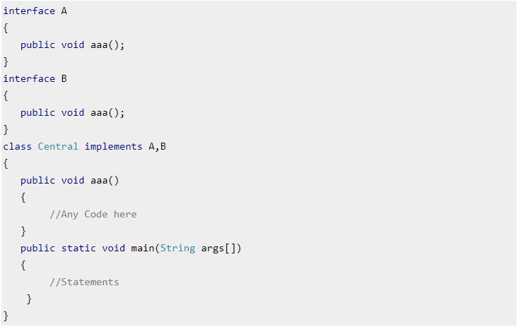

Slide 21
THANKS

